Slide 1
Shell Scripting Assignment
Atypon Training Program 2023
By Yussif Abdalla

Slide 2
Presentation Outline
Problem Definition
Introduction
Implementation
Optimization
Advanced Feature Integration
Conclusions, Reflections and Future Work

Slide 3
Problem Definition
Design, optimize, and benchmark a Linux based, user friendly feature-rich shell script that performs a complex task efficiently.
Present the work in three distinguished parts: implementation, optimization, and advanced feature integration.
Write an engineering report that covers the design choices, optimization techniques, advanced features, user-friendliness aspects, and their impact on performance.
Share conclusions, reflections, difficulties that are encountered, and provide potential future improvements.

Slide 4
Introduction
Shell scripting is essential to anyone works as a system administrator. Typically, Linux based machines boots up by executing shell scripts in /etc/rc.d to restore the system configuration and set up services.
Detailed understanding of such startup scripts is important for analyzing the behavior of a system, and possibly modifying it.
A shell script may be used to prototype a complex application, where a limited functionality that is generated by a script is often a useful first stage in project development.
Shell scripting dates back to the ubiquitous classic UNIX philosophy of breaking complex projects into simpler subtasks, which may be used for chaining together components and utilities

Slide 5
Script Design and Implementation

Slide 6
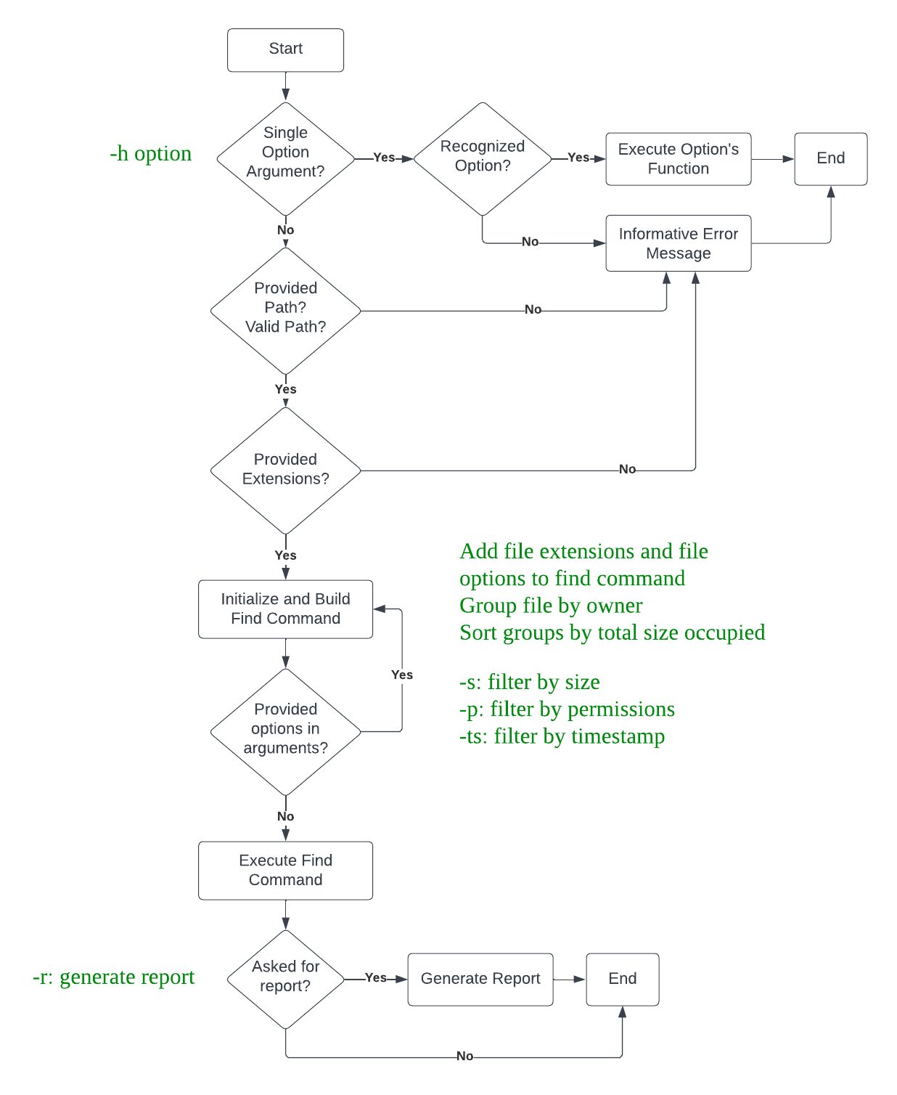
I. Script Flow Chart

Slide 7
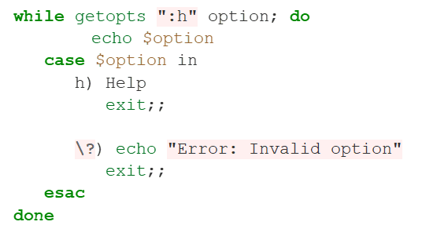
Handling Single Arguments
Handle single arguments provided by the user
The help option

Slide 8
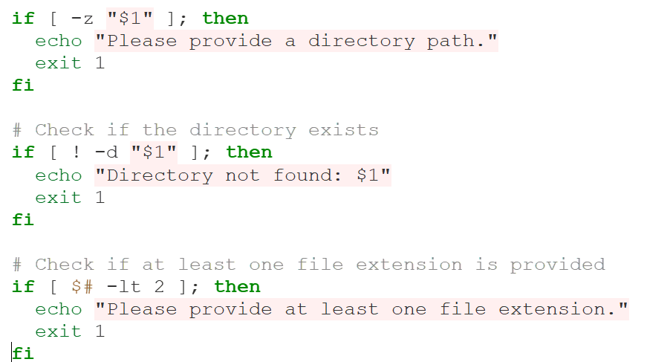
Input Validation

Slide 9
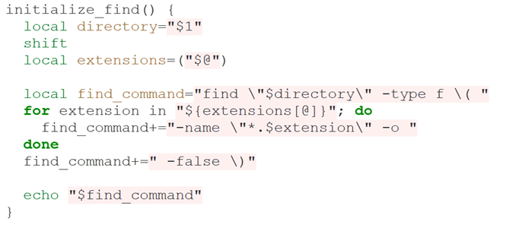
Initializing Find Command
Find command is set to search for file extensions
Appends extensions given from the user to the find command
Logical OR operator (-o) is used to separate extensions

Slide 10
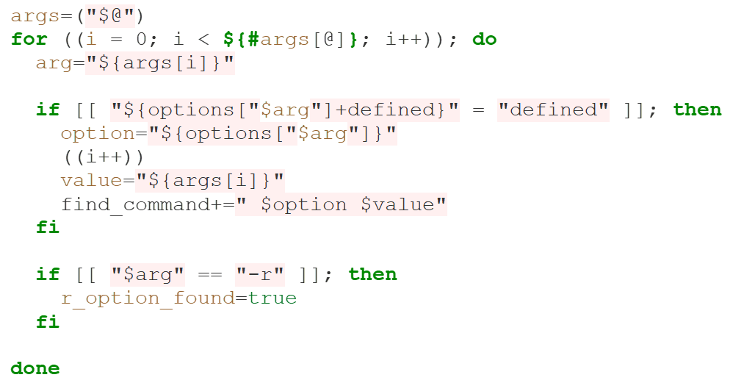
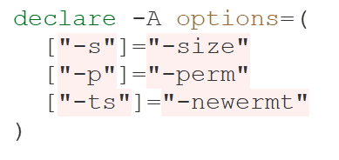
Building Find Command
Associative array stores key-value pairs
Key: options for filtering files, such as -s for size, -p for permissions, and -ts for timestamp
Value: corresponding options used by the find command to apply the filters
Customizable file filtering

Slide 11
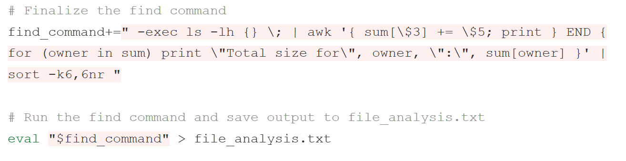
Finalizing Find Command
Display detailed information about the files
Size, owner, permissions
Group files by owner
Calculate size for each owner
Sort groups based on total size

Slide 12
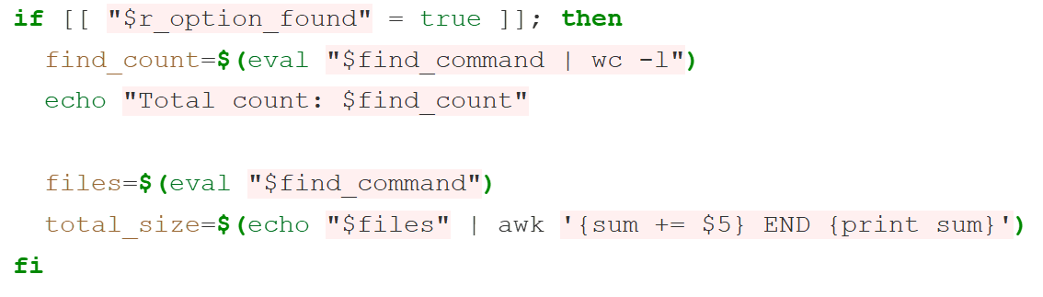
Generating Summary Report
Checks r_option_flag
Generate summary report
Total file count, total size, average size

Slide 13
Script Optimization

Slide 14
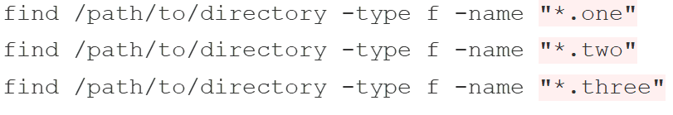
Optimization Techniques
Using a single find command
Options provided by the user are appended to a single find command
Avoid redundant directory traversals and unnecessary overhead
Reduces system calls
Code becomes more concise, readable, easier to understand and maintain
Enhances performance and improves efficiency

Slide 15
Optimization Techniques
Using associative array
Shell scripting optimization technique
Efficient and fast data lookup
Eliminates complex loops and multiple conditional statements
Eliminates redundant code blocks

Slide 16
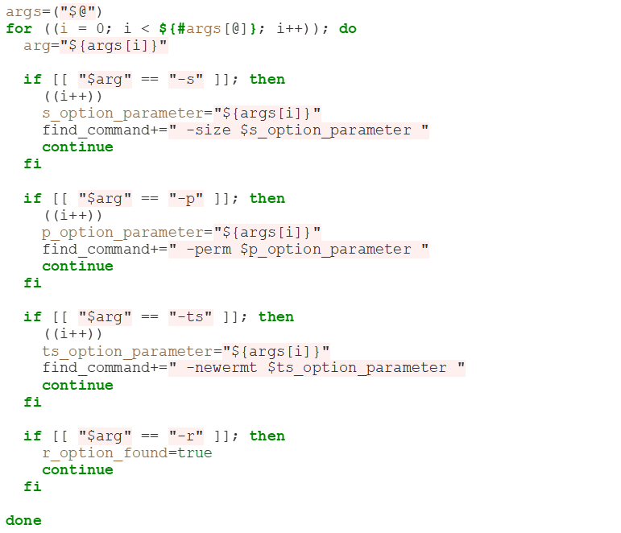
Optimization Techniques
Code before using associative array

Slide 17
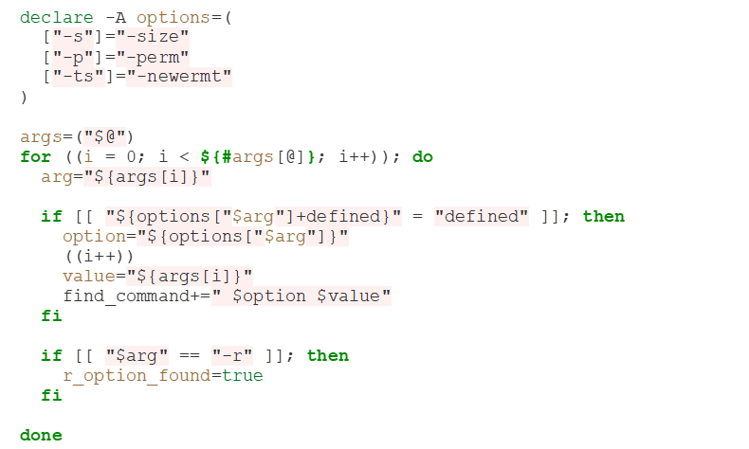
Optimization Techniques
Code after using associative array

Slide 18
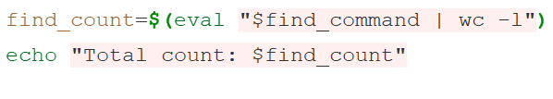
Optimization Techniques
Using wc –l command and avoid storing to file
Reduced memory usage
avoids storing entire output on memory or on the disk
Minimized processing overhead
Light weight operation
Reduced processing overhead
Line counting more efficiently with better performance

Slide 19
User Friendliness Aspects

Slide 20
User Friendliness Aspects
The script is designed to provide a user-friendly experience by incorporating the following several features
Clear Prompts
Error Handling
Help Section
Examples and Usage

Slide 21
Conclusions, Reflections and Future Work

Slide 22
Conclusions
Complete design, optimization, and benchmarking of a feature-rich shell script that performs a complex task efficiently is successfully coded and presented.
The work mainly focuses on Linux commands, shell scripting techniques, optimizing on strategies, and creating a user-friendly experience.
Collectively, the work is presented in detailed as three distinguished parts: implementation, optimization, and advanced feature integration.

Slide 23
Lessons Learned
Proficiency in various Linux commands and their practical usage.
How to effectively combine Linux commands to automate repetitive tasks and streamline workflows.
Acquired the ability to automate tasks according to specific requirements and customize system settings accordingly.
Good command of the command line interface
Gained strong problem-solving skills, enabling me to break down complex problems into manageable tasks and produce the necessary solutions to such problems.
Understanding the needs of users and facilitating their search for information
Realizing that Linux and shell scripting are continually evolving technologies

Slide 24
Difficulties Encountered
Challenges due to lack of familiarity with the wide range of options and commands available in Linux!
Searching for specific Linux commands that would suit design requirements.
Understanding how different commands interact with each other. As script combined various commands to achieve desired outcomes

Slide 25
Future Work and Recomendations
Introducing additional filtering options to filter files based on their timestamp, such as filtering by the last X days, minutes, or hours, would enhance its functionality.
Providing various export formats, including CSV or JSON, would offer users more flexibility in handling and analyzing the generated reports.
Giving users options to decide whether they want to search for the specified extensions in the directory alone or include subdirectories as well
Enhancing the generated report by incorporating additional relevant statistics analysis, such as file count by owner, file size distribution, or file permissions summary…etc.

Slide 26
References
[1] Mendel Cooper, An in-depth exploration of the art of shell scripting, PUBLICDOMAIN 10 Mar 2014, Revision 10.
[2] Chet Ramey, Bash Reference Manual, Case Western Reserve University Brian Fox, Free Software Foundation, Sep. 2022.
[3] Dr. Motasem Aldiab , Shell Scripting Assignment, Atypon Training Program 2023.

Slide 27
Thank You

